Slide 1
MAT 350 Engineering mathematics
Lecture -3
First order Linear ODE
Homogeneous ODE, Bernoulli’s Equations
Mohammad Sahadet Hossain, PhD
Associate Professor, Department of Mathematics and Physics
Additional Director, IQAC
North South University
mohammad.hossain@northsouth.edu

Slide 2
First-order differential equation: (Chapter 2.3) Linear differential equations:
A first-order differential equation of the form
(1)
is said to be a linear equation in the dependent variable y.
When g(x) = 0, the linear equation (1) is said to be homogeneous; otherwise, it is nonhomogeneous. The standard form, of the above linear equation
is
(2)
We seek a solution of (2) on an interval I for which both coefficient functions P and f are continuous.
If f(x)=0, one can solve (2) by variable separable method.

Slide 3
Linear differential equations:
(2)
When (2) is multiplied by a function μ (x), it becomes an exact differential equation. This function, μ (x) is known as integrating factor.
For a linear ODE (2) ; the integrating factor is given by
(3)
Multiply both sides of (2)

Slide 4
Integrating both sides w.r.t. x
Steps:
(i) Identify P(x) from the standard form (2)
(ii) Compute I.F. μ(x)
(iii) Multiply equation (2) with I.F and reduce to exact differential.
(iv) Solve for y

Slide 5





Linear differential equations
Solution: Comparing to the standard form (2), we see that P(x)= -3, and the integrating factor is
Then multiplying the given equation by this factor gives
Integrating both sides,

Slide 6
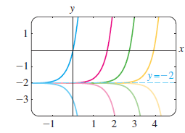

Linear differential equations:
y = y_{c} + y_{p}, where
y_{c} =ce^{3x} is the solution of the corresponding homogeneous eqn.,
And, y_{p}= -2 is a particular solution of the nonhomogeneous equation
0

Slide 7




Linear differential equations:
Multiplying by I.F gives
?
(-3,3) ignored

Slide 8
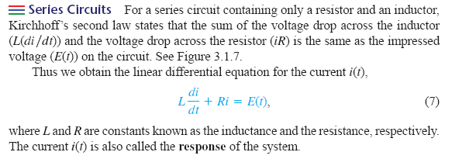
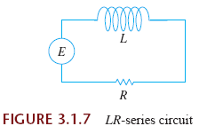

Slide 9








Solution: Hints
or,

Slide 10




Solution:

Slide 11


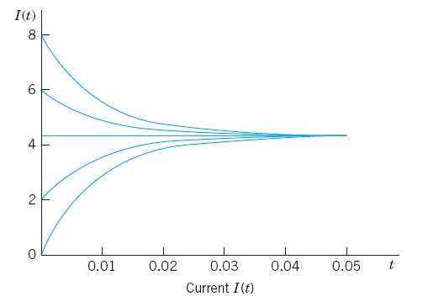
Model graph, not the exact one from the problem

Slide 12



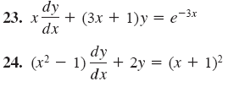
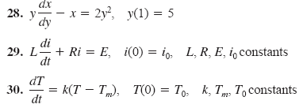
Exercises: 2.3

Slide 13
Solving Homogeneous First Order ODEs
(Chapter 2.5)
Homogeneous first order ODE
Bernoulli’s Equations

Slide 14
If a function f possesses the property
for some real number α , then f is said to be a homogeneous function of degree α .

Slide 15

A first-order DE in differential equation of the form
(H1)
is said to be homogeneous if both coefficient functions M and N are homogeneous functions of the same degree.
In other words, (H1) is homogeneous if
How to Solve: Either of the substitutions y= ux or x= vy, where u and v are new dependent variables, will reduce a homogeneous equation to a separable first-order differential equation.

Slide 16

After substituting, the given equation becomes

Slide 17
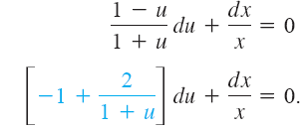





Slide 18

(H2)
Note that for n= 0 and n=1, the above equation is a linear ODE
any equation of form (H2) to a linear equation.

Slide 19


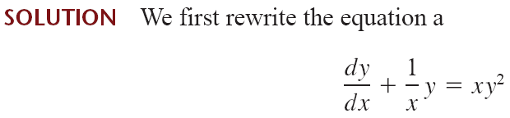





Slide 20





So a solution of the given equation is

Slide 21


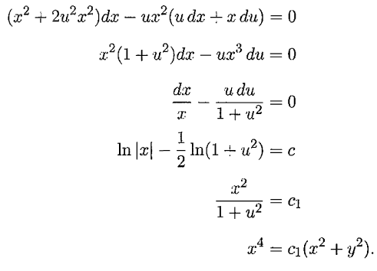
Exercise 2.5
+

Slide 22







Slide 23



End

